Slide 1
CELL TRANSPORT
Dr.T.S.Asta Eshwaran
Dept. of Physiology
SKHMC, Kulasekharam

Slide 2
CELL TRANSPORT
All the cells in the body must be supplied with essential substances like nutrients, water, electrolytes, etc. Cells also must get rid of many unwanted substances like waste materials, carbon dioxide, etc.
Cell membrane is well suited for the transport of substances in and out of the cell.

Slide 3
Lipids and proteins of cell membrane play an important role in the transport of various substances.
BASIC MECHANISM OF TRANSPORT
2 basic mechanisms are involved in cell transport
1. Passive Transport
2. Active transport

Slide 4
PASSIVE TRANSPORT
Also called as diffusion or downhill movement, it does not need energy.
Passive transport is the transport of substances along the concentration gradient or electrical gradient or both (electrochemical gradient).
The substances move from region of higher concentration to the region of lower concentration.

Slide 5
Diffusion is of two types
1. Simple diffusion
2. Facilitated diffusion.
Simple diffusion of substances occurs either through lipid layer or protein layer of the cell membrane.

Slide 6
Facilitated diffusion occurs with the help of the carrier proteins of the cell membrane.
1. Simple diffusion through lipid layer
2. Simple diffusion through protein layer
3. Facilitated or carrier-mediated diffusion

Slide 7
Simple diffusion through lipid layer
Lipid layer of the cell membrane is permeable only to lipid-soluble substances like oxygen, carbon dioxide and alcohol. Directly proportional to the solubility of substances.
Simple diffusion through protein layer
Protein layer of the cell membrane is permeable to water-soluble substances. Mainly, electrolytes diffuse through the protein layer.

Slide 8
Protein channels or ion channels
Throughout the central lipid layer of the cell membrane, there are some pores. Integral protein molecules of protein layer invaginate into these pores from either surface of the cell membrane. Thus, the pores present in the central lipid layer are entirely lined up by the integral protein molecules. These pores are the hypothetical pores and form the channels for the diffusion of water, electrolytes and other substances, which cannot pass through the lipid layer. As the channels are lined by protein molecules, these are called protein channels for water-soluble substances.

Slide 9
Types of protein channels.
Each channel can permit only one type of ions to pass through it.
Regulation of the channels
Ungated Channels: Continuously opened channels.
Gated Channels: Closed channels, open only when required.
Voltage- gated channels, Ligand-gated channels and Mechanically gated channels.

Slide 10
Facilitated or Carrier-Mediated Diffusion
Water-soluble substances having larger molecules are transported through the cell membrane with the help of a carrier protein. The substances are transported across the cell membrane faster than the transport by simple diffusion.
Glucose and amino acids are transported by facilitated diffusion.
Molecule of these substances binds with carrier protein. Now, some conformational change occurs in the carrier protein. Due to this change, the molecule reaches the other side of the cell membrane

Slide 11
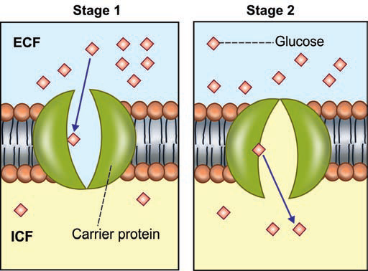

Slide 12
Factors Affecting The Rate Of Diffusion
Permeability of the cell membrane
Temperature: Rate of diffusion is directly proportional to the body temperature. Increase in temperature increases the rate of diffusion.
Concentration Gradient or Electrical Gradient of the Substance across the Cell Membrane: Rate of diffusion is directly proportional to the concentration gradient or electrical gradient of the diffusing substances across the cell membrane.

Slide 13
4. Solubility of the substance: Diffusion rate is directly proportional to the solubility of substances, particularly the lipid-soluble substances. Since oxygen is highly soluble in lipids, it diffuses very rapidly through the lipid layer.
5. Thickness of the cell membrane: Rate of diffusion is inversely proportional to the thickness of the cell membrane. If the cell membrane is thick, diffusion of the substances is very slow.

Slide 14
6. Size of the molecules: Rate of diffusion is inversely proportional to the size of the molecules.
7. Size of the Ions: Generally, rate of diffusion is inversely proportional to the size of the ions.
8. Charge of the Ions: Rate of diffusion is inversely proportional to the charge of the ions. Greater the charge of the ions, lesser is the rate of diffusion. For example, diffusion of calcium (Ca++) ions is slower than the sodium (Na+) ions.

Slide 15
SPECIAL TYPES OF PASSIVE TRANSPORT
Bulk Flow
Filtration
Osmosis
BULK FLOW
Movement of large quantity of substances from region of high pressure to the region of low pressure.
It is due to pressure gradient of the substance across the cell membrane.

Slide 16
FILTRATION
Movement of water and solutes from an area of high hydrostatic pressure to an area of low hydrostatic pressure is called filtration. Hydrostatic pressure is developed by the weight of the fluid.
Filtration process is seen at arterial end of the capillaries, where movement of fluid occurs along with dissolved substances from blood into the interstitial fluid.

Slide 17
OSMOSIS
It is defined as the movement of water or any other solvent from an area of lower concentration to an area of higher concentration of a solute, through a semipermeable Membrane. The semipermeable membrane permits the passage of only water or other solvents but not the solutes.

Slide 18
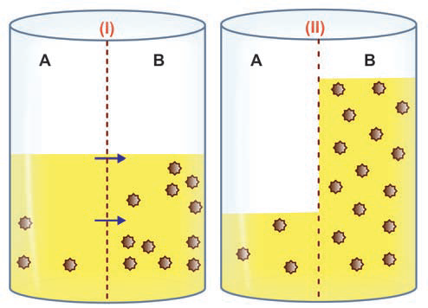
Process of Osmosis

Slide 19
Osmotic Pressure
Osmotic pressure is the pressure created by the solutes in a fluid. During osmosis, solvent moves from the area of lower concentration to the area of higher concentration, the solutes in the area of higher concentration get dissolved in the solvent. This creates a pressure which is known as osmotic pressure.
Types of Osmosis
1. Endosmosis:
2. Exosmosis:

Slide 20
ACTIVE TRANSPORT
Movement of substances against the chemical or electrical or electrochemical gradient.
It is like swimming against the water tide in a river. It is also called uphill transport. Active transport requires energy, which is obtained mainly by breakdown of high energy compounds like adenosine triphosphate(ATP).

Slide 21
Carrier Protein for Active Transport
Uniport
Symport or antiport
UNIPORT
Carrier protein that carries only one substance in a single direction is called uniport. It is also known as uniport pump.

Slide 22
SYMPORT or ANTIPORT
Symport or antiport is the carrier protein that transports two substances at a time.
Carrier protein that transports two different substances in the same direction is called symport or symport pump. Carrier protein that transports two different substances in opposite directions is called antiport or antiport pump.

Slide 23
Mechanism of Active Transport
When a substance to be transported across the cell membrane comes near the cell, it combines with the carrier protein of the cell membrane and forms substance-protein complex. This complex moves towards the inner surface of the cell membrane.
Now, the substance is released from the carrier proteins. The same carrier protein moves back to the outer surface of the cell membrane to transport another molecule of the substance.

Slide 24
Substances Transported by Active Transport
In ionic form and non-ionic form. Substances in ionic form are sodium, potassium, calcium, hydrogen, chloride and iodide. Substances in non-ionic form are glucose, amino acids and urea.

Slide 25
TYPES OF ACTIVE TRANSPORT
1. Primary Active Transport
2. Secondary Active Transport
PRIMARY ACTIVE TRANSPORT
The energy is liberated directly from the breakdown of ATP.
Sodium , Potassium, Calcium, Hydrogen and Chloride are transported.

Slide 26
Primary Active Transport of Sodium and Potassium: Sodium-Potassium Pump
Sodium and potassium ions are transported across
the cell membrane by means of a common carrier
Protein called sodium-potassium (Na⁺-K⁺) pump. It is
also called Na⁺-K⁺ ATPase pump or Na⁺-K⁺ ATPase.
This pump transports sodium from inside to outside
the cell and potassium from outside to inside the cell.
This pump is present in all the cells of the body.

Slide 27
Mechanism of action of Na⁺-K⁺ pump
Three sodium ions from the cell and two potassium ions from outside the cell got attached to their receptor sites of the carrier protein.
Binding of sodium and potassium ions to carrier protein activates the enzyme ATPase. The ATPase cause breakdown of ATP into adenosine diphosphate (ADP) with the release of one high energy phosphate.
Sodium ions are released outside the cell and potassium ions are released inside the cell.

Slide 28
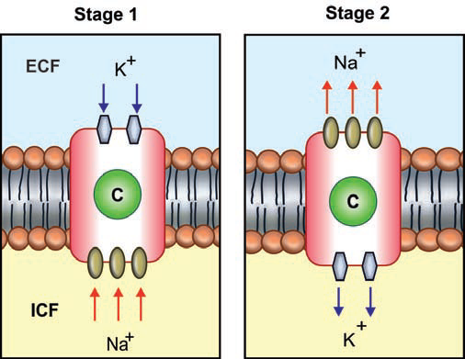
Sodium Potassium Pump

Slide 29
Electrogenic activity of Na⁺-K⁺ pump
It moves three sodium ions outside the cell and two
potassium ions inside the cell. Loss of one positively
charged ions from the cell. Continuous activity of
Na⁺-K⁺ cause reduction of +ly charged ions inside the
cell, leading to increase in the –ly charged ions inside
the cell. This is called Electrogenic activity of Na=-K+
pump.

Slide 30
SECONDARY ACTIVE TRANSPORT
Transport of substance with sodium ions, by means of
same carrier protein. When sodium is transported by a
carrier protein, another substance also transported by
the same carrier protein simultaneously either in same
direction or in the opposite direction.
2 types
1. Cotransport
2. Countertransport

Slide 31
Sodium Cotransport
Sodium cotransport is the process in which, along
with sodium, another substance is transported by a carrier
protein called symport. Energy for movement of sodium is
obtained by breakdown of ATP. And the energy released by
the movement of sodium is utilized for movement of another
substance.
Substances carried by sodium cotransport are
glucose, amino acids, chloride, iodine, iron and urate.

Slide 32
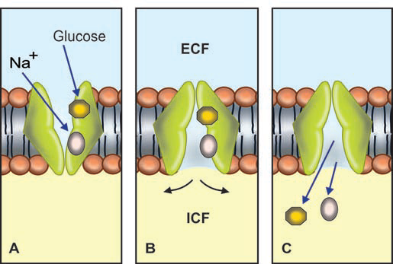
SODIUM COTRANSPORT

Slide 33
Carrier protein for sodium cotransport
Carrier protein for the sodium cotransport has two
receptor sites on the outer surface.
Among the two sites, one is for binding of sodium and
another site is for binding of other substance.
Sodium cotransport of glucose
Sodium cotransport of glucose occurs during
absorption of glucose from the intestine and
reabsorption of glucose from the renal tubule.

Slide 34
Sodium Counter Transport
Sodium counter transport is the process by which
the substances are transported across the cell membrane
in exchange for sodium ions by carrier protein called
antiport.
1. Sodium-calcium counter transport:
In this, sodium and calcium ions move in opposite
directions with the help of a carrier protein. This type of
transport of sodium and calcium ions is present in all
the cells.

Slide 35
2.Sodium-hydrogen counter transport:
In this system, the hydrogen ions are exchanged for
sodium ions and this occurs in the renal tubular cells.
The sodium ionsmove from tubular lumen into the
tubular cells and the hydrogen ions move from tubular
cell into the lumen.

Slide 36
SPECIAL TYPES OF ACTIVE TRANSPORT
In addition to primary and secondary active transport systems, there are some special categories of active transport which are generally called the vesicular transport.
Special categories of active transport:
1 Endocytosis
2 Exocytosis
3 Transcytosis.

Slide 37
ENDOCYTOSIS
Endocytosis is a transport macromolecules enter the cell. Macromolecules (substances with larger molecules) cannot pass through the cell membrane either by active or by passive transport mechanism. Such substances are transported into the cell by endocytosis.
1. Pinocytosis
2. Phagocytosis
3. Transcytosis

Slide 38
PINOCYTOSIS
Pinocytosis is a process by which macromolecules like bacteria and antigens are taken into the cells. It is otherwise called the cell drinking.
Mechanism of pinocytosis
Macromolecules (in the form of droplets of fluid)bind to the outer surface of the cell membrane
Now, the cell membrane evaginates around the droplets
Droplets are engulfed by the membrane

Slide 39
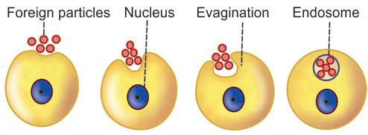
Process of Pinocytosis

Slide 40
Engulfed droplets are converted into vesicles and vacuoles, which are called endosomes.
Endosome travels into the interior of the cell
Primary lysosome in the cytoplasm fuses with endosome and forms secondary lysosome
Now, hydrolytic enzymes present in the secondary lysosome are activated resulting in digestion and degradation of the endosomal contents.

Slide 41
PHAGOCYTOSIS
Process by which particles larger than the
macromolecules are engulfed into the cells. It is also
called cell eating. Larger bacteria, larger antigens and
other larger foreign bodies are taken inside the cell by
means of phagocytosis.
Only few cells in the body like neutrophils,
monocytes and the tissue macrophages show
phagocytosis. Among these cells, the macrophages are
the largest phagocytic cells.

Slide 42
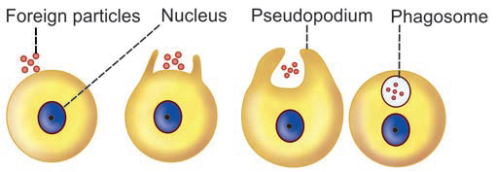
Process of Phagocytosis

Slide 43
Mechanism of Phagocytosis
When bacteria or foreign body enters the body, first the phagocytic cell sends cytoplasmic extension (pseudopodium) around bacteria or foreign body
Then, these particles are engulfed and are converted into endosome like vacuole.Vacuole is very large and it is usually called the phagosome
Phagosome travels into the interior of cell
Primary lysosome fuses with this phagosome and forms secondary lysosome
Hydrolytic enzymes present in the secondary lysosome are activated resulting in digestion and degradation of the phagosomal contents

Slide 44
RECEPTOR- MEDIATED ENDOCYTOSIS
Receptor-mediated endocytosis is the transport of
macromolecules with the help of a receptor protein.
Surface of cell membrane has some pits which contain a
receptor protein called clathrin. Together with a
receptor protein (clathrin), each pit is called receptor-
coated pit. These receptor-coated pits are involved in
the receptor mediated endocytosis.

Slide 45
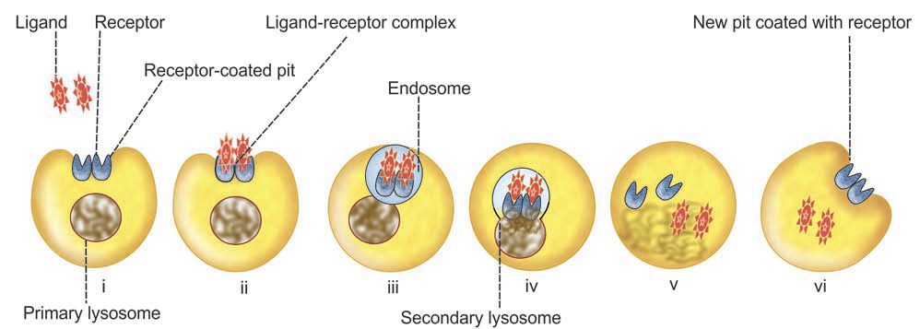
Mechanism of receptor-mediated endocytosis

Slide 46
Mechanism of receptor-mediated endocytosis
i. Receptor-mediated endocytosis is induced by
substances like ligands.
ii. Ligand molecules approach the cell and bind to receptors in the coated pits and form ligand-receptor complex.
iii. Ligand-receptor complex gets aggregated in the coated pits. Then, the pit is detached from cell membrane and becomes the coated vesicle. This coated vesicle forms the endosome.

Slide 47
iv. Endosome travels into the interior of the cell. Primary lysosome in the cytoplasm fuses with endosome and forms secondary lysosome.
v. Now, the hydrolytic enzymes present in secondary lysosome are activated resulting in release of ligands into the cytoplasm.
vi. Receptor may move to a new pit of the cell membrane.

Slide 48
Receptor-mediated endocytosis play an important role in the transport of several types of macromolecules into the cells.
i. Hormones: Growth hormone, thyroid stimulating hormone, luteinizing hormone, prolactin, insulin, glucagon, calcitonin and catecholamines.
ii. Lipids: Cholesterol and low-density lipoproteins(LDL).
iii. Growth factors (GF): Nerve GF, epidermal GF, platelet-derived GF, interferon.
iv. Toxins and bacteria: Cholera toxin, diphtheria toxin, pseudomonas toxin, recin and concanavalin A.

Slide 49
v. Viruses: Rous sarcoma virus, semliki forest virus, vesicular stomatitis virus and adenovirus.
vi. Transport proteins: Transferrin and transcobalamine
vii. Antibodies: IgE, polymeric IgG and maternal IgG.
Some of the receptor-coated pits in cell membrane are coated with another protein called caveolin instead of clathrin. Caveolin-coated pits are concerned with the transport of vitamins into the cell.

Slide 50
EXOCYTOSIS
Process by which the substances are expelled from
the cell. In this process, the substances are extruded
from cell without passing through the cell membrane.
This is the reverse of endocytosis.

Slide 51
Mechanism of Exocytosis
Exocytosis is involved in the release of secretory
substances from cells. Secretory substances of the
cell are stored in the form of secretory vesicles in the
cytoplasm. When required, the vesicles approach the
cell membrane and get fused with the cell membrane.
Later, the contents of the vesicles are released out of
the cell

Slide 52
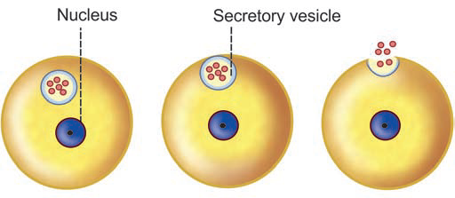
Mechanism of Exocytosis

Slide 53
Role of Calcium in Exocytosis
Calcium ions play an important role during the
release of some secretory substances such as
neurotransmitters. The calcium ions enter the cell and
cause exocytosis. However, the exact mechanism of
exocytosis is not clear.

Slide 54
TRANSCYTOSIS
Transcytosis is a transport mechanism in which
an extracellular macromolecule enters through one side
of a cell, migrates across cytoplasm of the cell and exits
through the other side.
Transcytosis plays an important role in selectively
transporting the substances between two environments
across the cells without any distinct change in the
composition of these environments.

Slide 55
APPLIED PHYSIOLOGY
Abnormalities of sodium-potassium pump
Abnormalities in the number or function of Na+-K+
pump leads
1. Reduction in either the number or concentration of Na+-K+ pump in myocardium is associated with cardiac failure
2. Excess reabsorption of sodium in renal tubules is associated with hypertension.

Slide 56
Channelopathies or Ion channel diseases
Channelopathies or ion channel diseases are caused
by mutations in genes that encode the ion channels.
Sodium Channel Diseases
Dysfunction of sodium channels leads
1. Muscle spasm
2. Liddle’s syndrome (dysfunction of sodium channels
in kidney resulting in increased osmotic pressure in the
blood and hypertension).

Slide 57
Potassium Channel Diseases
1. Cardiac failure
2. Inherited deafness
3.Epileptic seizures in newborn.
Chloride Channel Diseases
1. Renal stones
2. Cystic fibrosis.
Cystic fibrosis is a generalized disorder affecting the
functions of many organs such as lungs (due to excessive
mucus), exocrine glands like pancreas, biliary system and
immune system.

Slide 58
THANK YOU

